Slide 1
Practice Session Problem (1)
Initial beam conditions: 100pC, 100 MeV, total 3 mm beam with longitudinally
uniform distribution in z, Gaussian energy distribution with standard deviation
2keV, no chirp, transverse round upright 4D Gaussian distribution with 0.2 mm
RMS size, and 0.5 um normalized emittance.
Linac parameters: L1 (1.3GHz, 20m, 16MV/m), k = 0.61685
HL (3.9GHz, 5m, 10MV/m), k = 0.61685
L2 (1.3GHz, 200m, 16MV/m), k = 0.61685
L3 (1.3GHz, 400m, 16MV/m), k = 0.61685
BC1 R56 = 5 cm, L = 10, k = 0.27416
BC2 R56 = 5 cm, L = 20, k = 0.27416

Slide 2
Practice Session Problem (2)
1) Find the final electron beam bunch length at the end of L3,
estimate FEL radiation wavelength, bandwidth, and power,
compute speedup of your program
Find the final electron beam energy spread at the end of L3,
estimate FEL radiation wavelength, bandwidth, and power,
compute speedup of your program
3) Find the final electron beam emittance at the end of L3,
estimate FEL radiation wavelength, bandwidth, and power,
compute speedup of your program

Slide 3
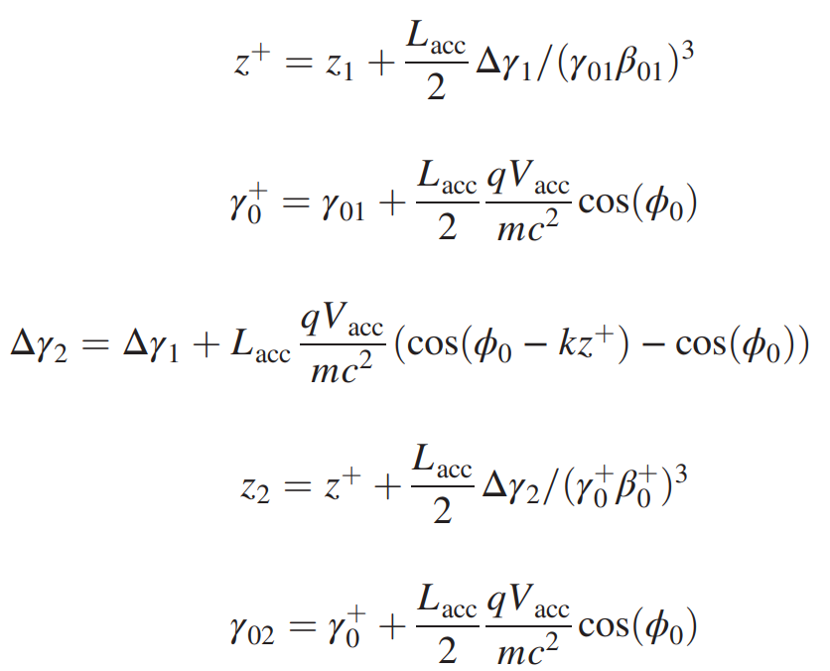
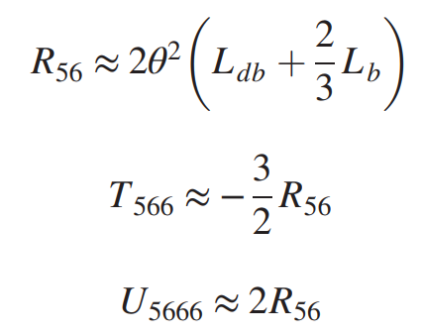
Longitudinal Dynamics Inside the Accelerator
RF cavity
bunch compressor
z: longitudinal relative position deviation w.r.p. reference particle position
Δγ: longitudinal normalized relative energy deviation w.r.p. reference particle energy
Δγ₂ = Δγ₁

Slide 4
Transfer Matrix through Linac and Bunch Compressor
Linac Transfer Matrix
Bunch Compressor Transfer Matrix
R56

